Slide 1
Wireshark as a part of your DevOps Cycle
How to include automated integration testing into your CI/CD practice using Wireshark
Milorad Imbra
Software Architect

Slide 2
Agenda
Distributed nature of modern SaaS solutions
Stripe & Auth0 as examples (+ Demo – Stripe)
(Micro)services integration and Message Queues
RabbitMQ
AMPQ Protocol (+ Demo)
Wireshark and Elasticsearch
DevOps
CI/CD with Jenkins
Notes:
Good morning, welcome to today’s first talk. I guess you’re a bit tired, there was a lot of information presented in previous days, so I’m gonna take it a bit more lightly - and talk about the broader picture, the DevOps cycle and where Wireshark might fit into it. Since we’re gonna aim to automate as much as we can in the DevOps cycle, we’re gonna rely mostly on TShark, and after this talk you have an “Automate your analysis: tshark, the Swiss army knife” talk which will give you more details about the TShark itself.
We’re going to start with the state of modern SaaS solutions
And give examples of integration with external services that provide critical functionality, like Stripe
And then give an example/demo of capturing the traffic to/from external services (in this case, Stripe)
After that, we’re gonna talk about the enterprise integrations and focus on message queues and one very popular implementation – RabbitMQ
And give a Demo of how it is used
Then talk about the AMQP protocol and Demo it with Wireshark
And how you can import that data into Elasticsearch (and why would you do it)

Slide 3
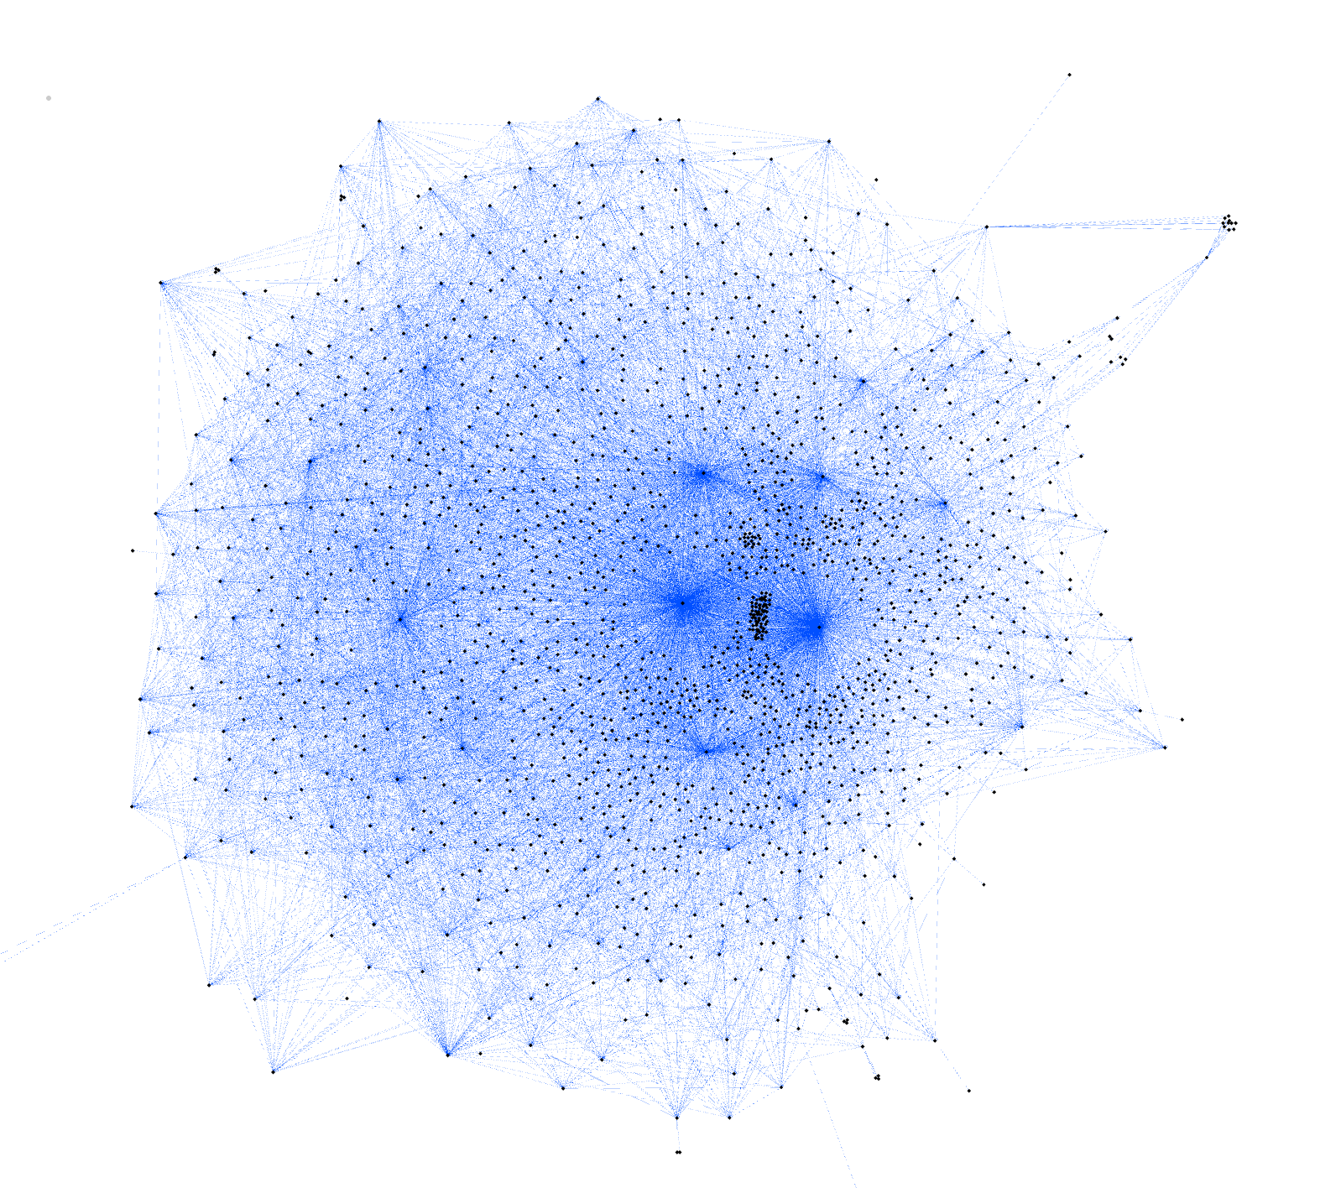
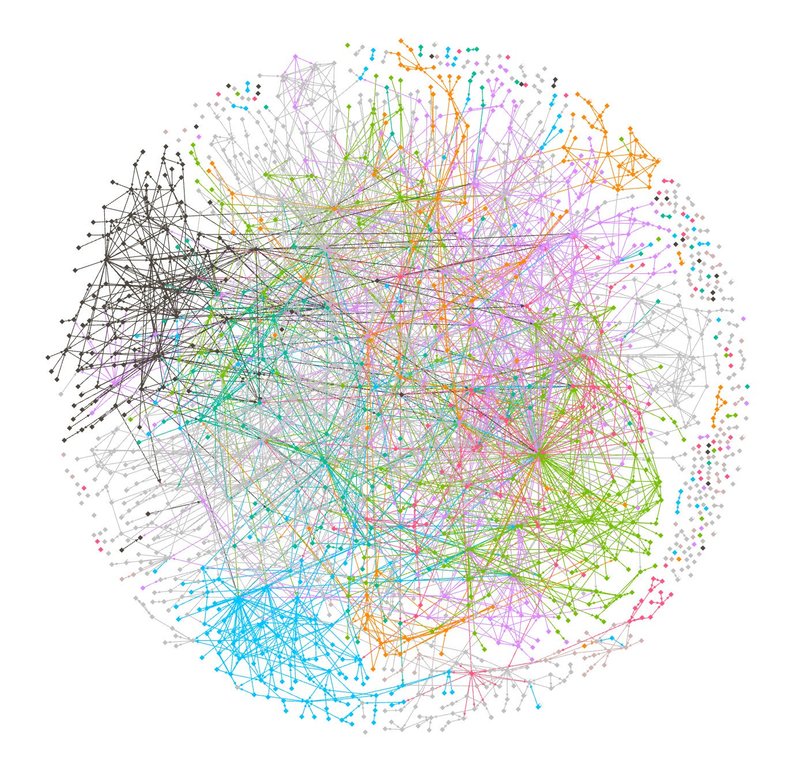
Modern SaaS
1500 microservices @monzo

Slide 4
Modern SaaS
Highly distributed systems
Scalable
Cloud-based
Microservices – independent scalability
Critical functionalities depend on other services
Complex testing and monitoring

Slide 5
Stripe integration
Organized around REST
Predictable resource-oriented URLs
Form-encoded request bodies
JSON-encoded responses
Uses standard HTTP response codes, authentication, and verbs

Slide 6
Stripe integration - DEMO

Slide 7
Distributed systems in Enterprise
The network is reliable.
Latency is zero.
Bandwidth is infinite.
The network is secure.
Topology doesn't change.
There is one administrator.
Transport cost is zero.
The network is homogeneous
DON’T ASSUME THIS!

Slide 8
How queues can help?
Decoupling workloads
Temporal decoupling
Load Balancing
Load leveling
Cross-platform integration
Asynchronous workflow
Deferred processing
Reliable messaging
Resilient message handling
Non-blocking receivers

Slide 9
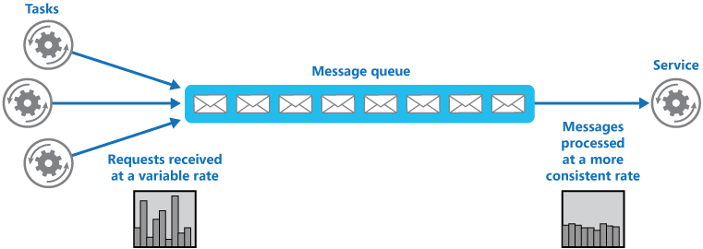
Patterns
Queue-Based Load Leveling pattern
Notes:
The queue acts as a buffer, storing the message until it's retrieved by the service. The service retrieves the messages from the queue and processes them. Requests from a number of tasks, which can be generated at a highly variable rate, can be passed to the service through the same message queue.

Slide 10
RabbitMQ
the most popular open source message broker
lightweight and easy to deploy on premises and in the cloud
supports multiple messaging protocols
can be deployed in distributed configurations (clusters) to meet high-scale, high-availability
libraries!

Slide 11
AMQP (0.9.1)
Advanced Message Queueing Protocol
open standard for messaging middleware
Notes:
AMQP (Advanced Message Queuing Protocol) is a binary
transfer protocol that was made for enterprise applications
and server-to-server communication (e.g., for financial
businesses), but today it can be very useful in the Internet
of Things world, thanks to the following primary features.
AMQP is binary and avoids a lot of the useless data sent
on the wire when using a text-based protocol like HTTP;
because of this, it can be considered compact, too.
Thanks to its multiplexed nature, only one connection
(over a reliable stream transport protocol) is needed to
allow separated data flows between the two peers; and of
course it’s symmetric and provides both a client-server
communication style and peer-to-peer exchange. Finally,
it’s secure and reliable, providing three different levels of
QoS (Quality of Service).
AMQP is a wire-level protocol plus a model for routing and queueing messages
The AMQP 0-9-1 Model has the following view of the world: messages are published to exchanges, which are often compared to post offices or mailboxes. Exchanges then distribute message copies to queues using rules called bindings. Then the broker either deliver messages to consumers subscribed to queues, or consumers fetch/pull messages from queues on demand.
Networks are unreliable and applications may fail to process messages therefore the AMQP 0-9-1 model has a notion of message acknowledgements: when a message is delivered to a consumer the consumer notifies the broker, either automatically or as soon as the application developer chooses to do so. When message acknowledgements are in use, a broker will only completely remove a message from a queue when it receives a notification for that message (or group of messages).

Slide 12
RabbitMQ - DEMO
docker pull rabbitmq
docker pull rabbitmq:3.7.8-management
docker run --rm -it -p 15671:15671/tcp -p 15672:15672/tcp -p 25672:25672/tcp -p 4369:4369/tcp -p 5671:5671/tcp -p 5672:5672/tcp rabbitmq:3.7.8-management

Slide 13
Elasticsearch
Popular search engine and platform
Store and organize test data
Integrate with other signals for analysis
Elasticsearch, Logstash, Kibana
Notes:
You cannot understand the whole picture if you don’t have your data points in context and related to each other.

Slide 14
Elasticsearch - DEMO
Notes:
tshark -r /Users/imbra/Downloads/sftest02.pcap -T ek > /Users/imbra/Downloads/sdtest02.pcap.json
curl -s -H "Content-Type: application/x-ndjson" -XPOST "localhost:9200/packets-2019-11-06/_bulk" --data-binary "@/Users/imbra/Downloads/sdtest02.pcap.json";
layers.amqp.amqp_method_arguments_amqp_method_arguments_heartbeat :*

Slide 15
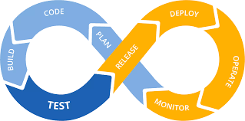
DevOps
Culture
Practices
Tools
to continually provide value to customers.
Notes:
A compound of development (Dev) and operations (Ops), DevOps is the union of people, process, and technology to continually provide value to customers.
What does DevOps mean for teams? DevOps enables formerly siloed roles—development, IT operations, quality engineering, and security—to coordinate and collaborate to produce better, more reliable products. By adopting a DevOps culture along with DevOps practices and tools, teams gain the ability to better respond to customer needs, increase confidence in the applications they build, and achieve business goals faster.

Slide 16
Wireshark in DevOps
Notes:
As we saw, Wireshark definitely has it’s place in TEST phase,
Also in monitoring deployed applications
In operations when troubleshooting
And in deploy as a part of it being deployed as infrastructure (monitoring, ops)

Slide 17
Jenkins - DEMO
tshark -i lo0 -c 2000 -T ek -Y "amqp"> /Users/imbra/Downloads/packetsTest.json
Notes:
tshark -i lo0 -c 20 -T ek -Y "amqp"> /Users/imbra/Downloads/packetsTest.json

